Slide 1


STRUCTURAL POLYSACCHRIDE
PRESENTED BY
Asif Mirza
Babar Ali
Sufiyan
M. Tehseen
Shoaib Shafiq
Akhuwat F.I.R.S.T
10/10/2018
1

Slide 2
INTRODUCTION
These are the polysacchride which plays structural role in organisms They may be homo or hetro polysacchride.
Examples
Cellulose
Lignin
Dextran
Chitin
Hyaloronic acid

Slide 3
CELLULOSE
Cellulose is the most abundant carbohydrate in nature.
cellulose molecule is a linear, unbranched homopolysaccharide, consisting of 10,000 to 15,000 D-glucose units.
Cotton is the pure form of cellulose.
It is the basic structural constituent of the cell walls of plants 33% vegetable 90% cotton 50% wood
It is highly insoluble in water.
10/10/2018
3

Slide 4
It resembles with amylose (amylose is a component of storage polysaccharide starch)
But it differs except linkage because in cellulose the glucose residues have the β- configuration and linked by β-1,4 -glycosidic bond.
starch ingested in the diet are hydrolyzed by α-amylases and glycosidases, enzymes in saliva and the intestine that break α- 1,4- glycosidic linkage between glucose units.
10/10/2018
4

Slide 5
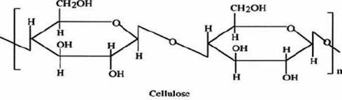
10/10/2018
5

Slide 6
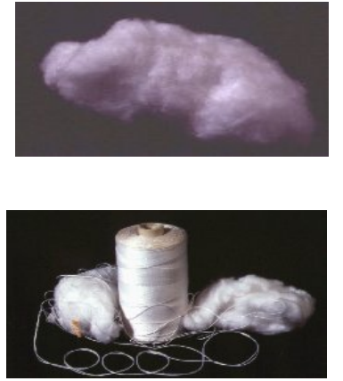
APPLICATIONS OF CELLULOSE:
Cotton:
Cotton is composed of 87 -90% cellulose with the cotton fibers containing polymer chains in both amorphous and crystalline forms
It is stiff and has a high tensile strength
Absorbs water without feeling wet
Absorbs heat
Clothes, dyes, building materials, and papers
10/10/2018
6

Slide 7
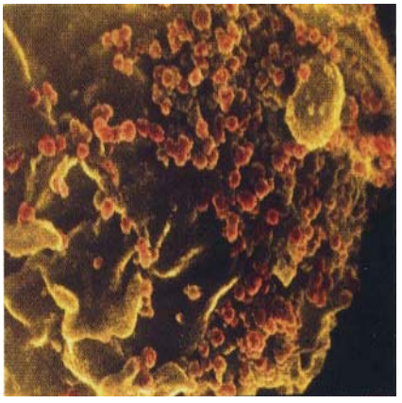
2. Pharmaceuticals:
They are used in chemically synthesized madicen e.g (cellulose acetate phthalate)
10/10/2018
7

Slide 8
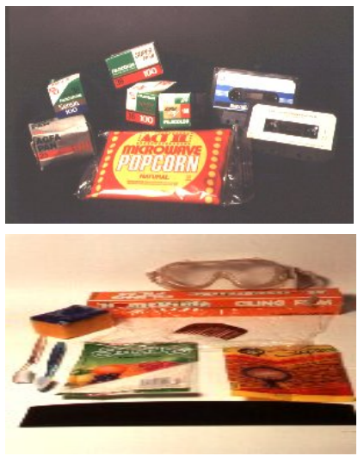
3. Cellophane
Can be obtained when a viscous cellulose reacts with acid (sulfuric acid) to produce cellophane, further treatment such as washing and bleaching.
Highly impermeable to dry gases and bacteria
10/10/2018
8

Slide 9
LIGNIN
Lignin is a structural polysaccharide.
It is second abundant and important organic substance on earth.
The incorporation of lignin into the cell walls of plants gave them rigid and woody.
Lignin increased the mechanical strength properties to such an extent that huge plants such as trees with heights of even more than 100 m can remain upright.
10/10/2018
9

Slide 10
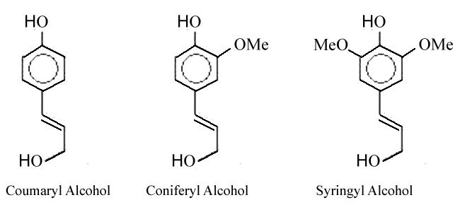
STRUCTURE
lignin structure is composed of up to three different phenyl propane monomers such as coniferyl alcohol, syringyl alcohol and coumaryl alcohol
coumaryl alcohol in grasses and agricultural crops.
coniferyl alcohol dominant in softwoods
syringyl in hardwoods
10/10/2018
10

Slide 11
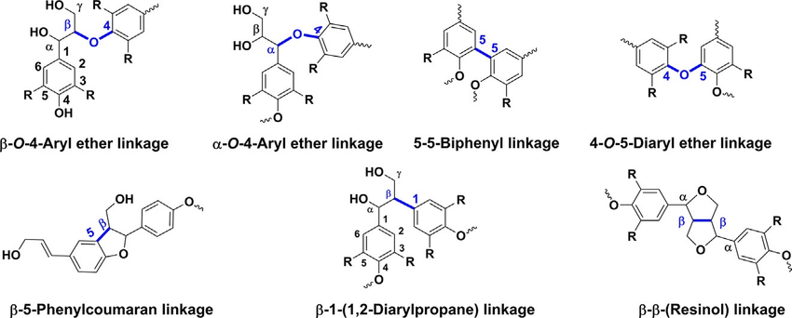
Lignin Linkage

Slide 12
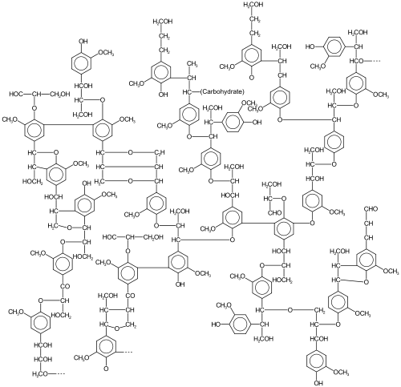
Example:
An aspen is a lignin have 63.4% carbon, 5.9% hydrogen, 0.7% ash (mineral components), and 30% oxygen.
Formula:
(C₃₁H₃₄O₁₁)_{n}.
10/10/2018
12

Slide 13
FUNCTIONS
It is responsible for providing construction of plants as like grasses, bushes and rigid trees.
The lignin in plants is less hydrophilic compare to cellulose hence it prevents the absorption of water.
The lignin in plants also works as a barrier against attack by insects and fungi.
Supportive agent → mechanical strength
Antioxidant → protection
Cross linker → cross link carbohydrates
Commercial use of Lignin: It can be utilized in many industries such as pulp & paper, agriculture and construction
10/10/2018
13

Slide 14
Dextran
Dextron is structural polysacchride.
These polysaccharide are formed when leuconostoc mesenteroides and some other microorganism are grown in sucrose solution.
The dextran molecule have different size, some having a molecular weight up to 40,00000.
Their solution are highly viscous.
10/10/2018
14

Slide 15
STRUCTURE
Dextran is complex branched glucon (polysaccharides derived from the condensation of glucose)
Dextran chains are of varying length (From 3 to 2000 kiloDalton)
The polymer main chain consist of alpha 1-6 glycosidic linkage between glucose monomer, with branch from alpha 1-3 linkages.
10/10/2018
15

Slide 16
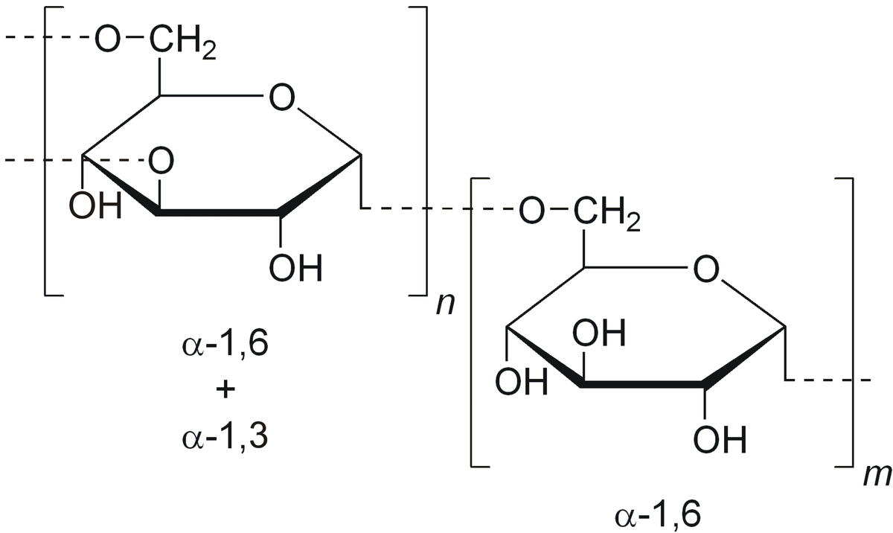
α 1-3 and α 1-6 linkage
10/10/2018
16

Slide 17
PROPERTIES
The versatile use of dextran products relate to favourable properties.
Dextran is neutral and water soluble.
Dextran is easily filtered.
Dextran is bio-compatible.
It is bio degderable.
Dextran is stable for more than 5 years.
10/10/2018
17

Slide 18
USES
Dextran are use in medicine as plasma substitute are extender in the treatment of hypovolemic shock (decrease volume of blood circulating plasma) that can result from injury and other causes of bleedings.
It is used in some eye drops as a lubricants.
Dextran is used in osmotic stress techniques for applying osmotic pressure to biological molecule.
10/10/2018
18

Slide 19
CHITIN
It is long chain polymer of N- acetyleglucosamine.
N- acetylegulosamine is a derrivative of glucose.
Chitin is also well known because it is a primary component of arthopod exo skeleton.
10/10/2018
19

Slide 20
Occurrence
It is present in arthopods, fungi, molluskan and other lower animal and vertebrates.
Moreover in these organisms it also play a key functional role.
Sutructers formation is also accompained by chitin
10/10/2018
20

Slide 21
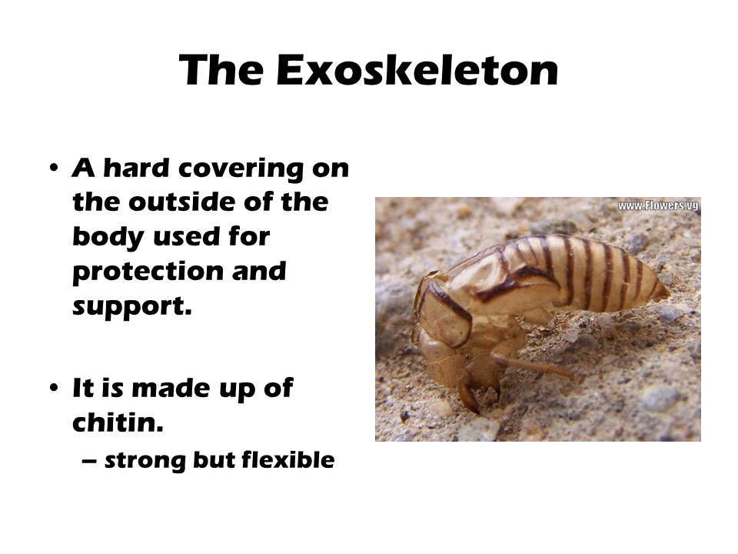
In Arthopods
10/10/2018
21

Slide 22
In fungi
Primary component of fungal cell wall is chitin.
It also provide rigidity to fungi cell wall.
In mollusks
Radulae(an organ looked like spiked tongue) is made up of chitin.
This radulae is used to scrap algae and food particles.
10/10/2018
22

Slide 23
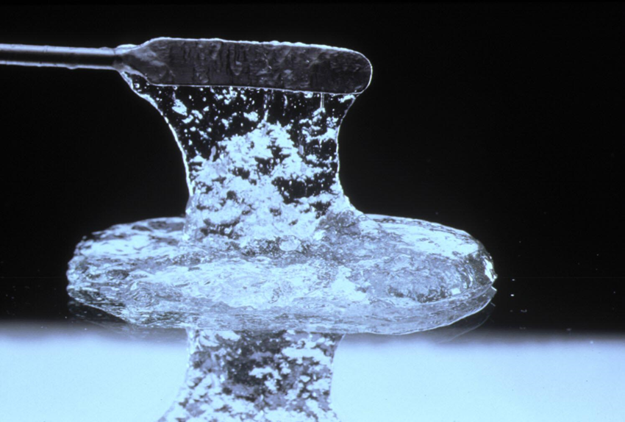
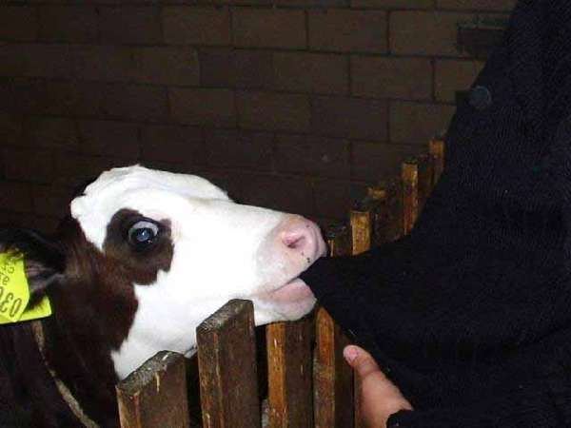
HYALURONIC ACID
10/10/2018
23
23

Slide 24
INTRODUCTION
Hyaluronic acid also called hyaluronan play structural role in body.
It is a unbranched hetropolysaccharide and is composed of repeating units i.e.
- Glucuronic acid
- N‐acetyl‐d‐glucosamine
10/10/2018
24
24

Slide 25
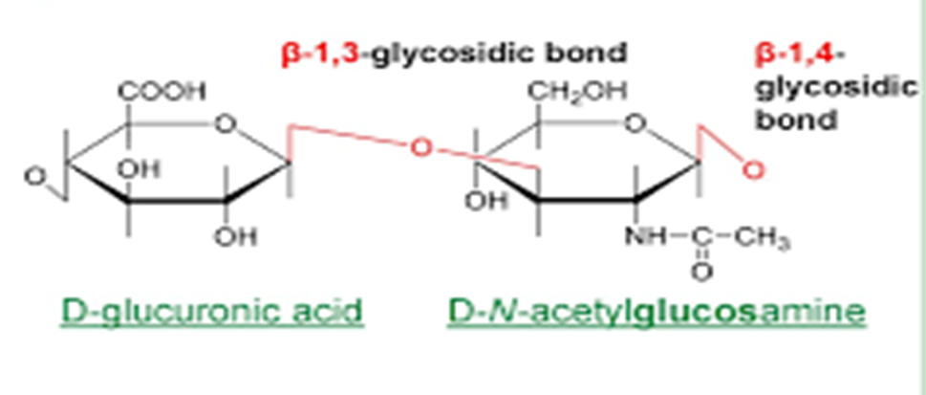
STRUCTURE
It consists of repeating disacharides units
- N‑acetylglucosamine
- Glucuronic acid
Theseunits are joined by beta‑1,4 and beta‑1,3 glycosidic bonds.
10/10/2018
25
25

Slide 26
OCCURENCE
In the skin (about 50 % of the total hyaluronan in the body).
In the vitreous humour of the eye.
In the synovial fluid (3‑4 mg/ml).
In the matrix around the oocyt during ovulation.
In some situations rapid increase i.e.
(shock incidents, wound healing, septicaemia)
Hyaluronic acid is also a component of streptococcal capsule.
10/10/2018
26
26

Slide 27
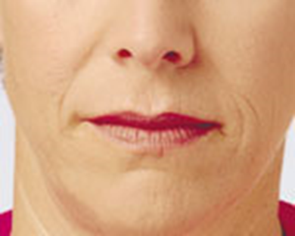
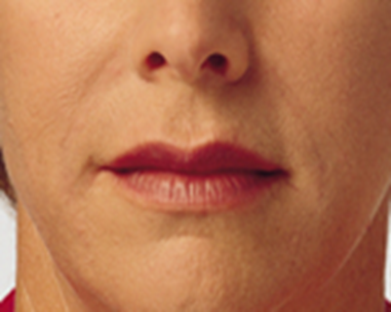
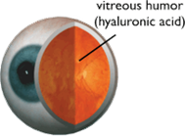
Medical uses
As vitreous humour replacement during eye surgery.
To improve the effectiveness of local anaesthesia.
In plastic surgery i.e. for bigger an better lips.
Before
After
10/10/2018
27
27

Slide 28
Dry scaly skin is treated with skin lotion containing sodium hyaluronate.
Hyaluronic acid is used to create artificial tears to treat dry eye.
Hyaluronan improves properties of synovia and silences pain in joints.
Prevent tissue destruction.
Hyaluronic acid is used as a tumor marker for prostate and breast cancer.
It may also be used to monitor the progression of the disease.
10/10/2018
28
28

Slide 29
SYNOVIAL FLUID
Synovial fluid is secreted by the joint tissues.
It is called synovial fluid because of its resemblance to egg white.
(Syn : like , ovia : egg)
It is a viscous, mucinous substance that lubricates most joints.
Degradation of synovial fluid leads to osteoarthritis.
10/10/2018
29
29

Slide 30
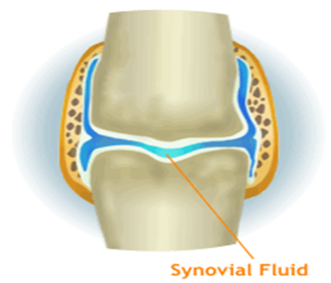
Viscosupplementation.
In Viscosupplementation we treat osteoarthritis by injecting Viscosupplementations into the joint.
Osteoarthritis is the condition in which synovial fluid decreases as a result bones at joint hinders the movement due to friction and cause sever pain.
Viscosupplements are synthetically or biologically derived Hyaluronic Acid.
Which lubricates the joints.
10/10/2018
30
30

Slide 31


